Slide 1

AI and Data Science
PYTHON PROGRAMMING
Conditions and Loops
Dr Ganapathi Raju

Slide 2
Introduction to Branching and Looping
Generally, Programs contain set of Statements.
Set of statements, gets executed sequentially in the order in which they are written and appear. But situations may arise where we may have to change the order of execution of statements depending on specific conditions. This involves a kind of decision making from a set of logical conditions/tests.
Decision structures is to evaluate one or multiple expressions/logical conditions, which return True or False outcomes. We can then determine what actions the program should take by defining the statements to execute when the outcome is TRUE or FALSE.
A loop is an instruction that repeats multiple times as long as some condition is met.

Slide 3
Branching Statements
Python has three major decision making instructions—
if statement
if-else statement
if...elif...else statement

Slide 4
Branching: if statement
The if statement is used to carry out a logical expression, returns Boolean.
The expression in parentheses must produce a Boolean result
At run time, the computer evaluates the expression as True/False
If True, the computer executes Statement(s).
If False, goes out of if condition
if keyword and ends with a colon ( : )
In Python, the if block statements are determined through indentation and the first un-indented statement marks the end.
if ( expression ) :
statement(s)
colon
indentation

Slide 5
Example on if statement
If the expression returns True, prints statements.
Note:
There is no limit on the number of statements that can appear in the body,
but there must be at least one.
It is useful to have a body with no statements
Use the pass statement, which does nothing.
x = 10
if (x >= 10 ):
print("x >= 10 ",x)
x >=10
expression is True
print("x >= 10 ", x)

Slide 6
if...else... statement
A second form of the if statement in which there are two possibilities and the condition determines which one gets executed.
if ( expression ) :
statement(s) 1 ;
else:
statement(s) 2 ;
expression is True
column
expression is False
expression
indentation
True
column
indentation
False
Statements 1
Statements 2

Slide 7
Programs on if...else...
Program to Find If a Given Number Is Odd or Even
Program to Find the Greater of Two Numbers
x = 10
if x%2 == 0 :
print('x is even', x)
else :
print('x is odd', x)
x, y=10,20
if (x > y):
print("x is big",x)
else:
print("y is big",y)

Slide 8
if…elif…else statement (multy-way control)
When you need to choose from several possible alternatives, then an elif statement is used along with an if statement.
If expression 1:
statement 1
elif expression 2:
statement 2
:
:
:
else:
statement last
If expression 1 is True, then statement_1 is executed.
If expression 1 is False and expression 2 is True, then statement 2 is executed.
If none of the expression is True, then statement last is executed.

Slide 9
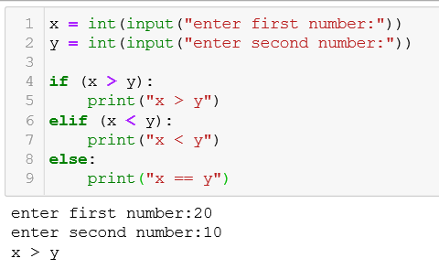
Program using if…elif…else statement
Program to find whether a given number is greater than / less than / equal to another.
x = int(input("enter first number:"))
y = int(input("enter second number:"))
if (x > y):
print("x > y")
elif (x < y):
print("x < y")
else:
print("x == y")

Slide 10
range()
The range() type returns an immutable sequence of numbers between the given start integer to the stop integer.
range() constructor has two forms of definition:
range(stop)
range(start, stop[, step])
start - integer starting from which the sequence of integers is to be returned
stop - integer before which the sequence of integers is to be returned. The range of integers end at stop - 1.
step (Optional) - integer value which determines the increment between each integer in the sequence
range() returns an immutable sequence object of numbers depending upon the definitions used:

Slide 11
Loops (Iterative Statements)
A loop is an instruction that repeats multiple times as long as some condition is met.
Loops help us remove the redundancy of code when a task has to be repeated several times.
The two types of loops in Python programming are while and for

Slide 12
for loop
Probably the most popular looping instruction.
The for loop starts with for keyword and ends with a colon.
The first item in the sequence gets assigned to the iteration variable iteration_variable. iteration_variable can be any valid variable name. Then the statement block is executed.
This process of assigning items from the sequence to the iteration_variable and then executing the statement continues until all the items in the sequence are completed.
Actually, the for loop is designed to do more complicated tasks - it can "browse" large collections of data item by item.
for iteration_variable in sequence:
statement(s)

Slide 13
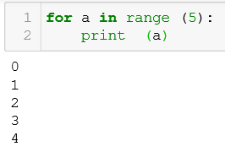
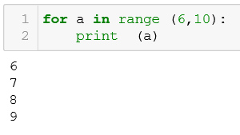
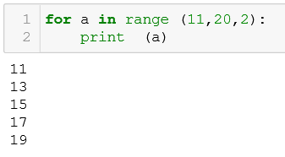
Example for loop with range()
for a in range (5):
print (a)
for a in range (6,10):
print (a)
for a in range (11,20,2):
print (a)

Slide 14
for loop with string
Program to Iterate through Each Character in the String
for ch in 'Python’:
print(ch)

Slide 15
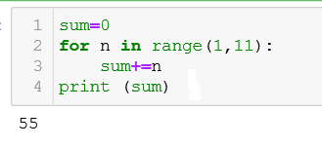
Example for loop
Program : Sum of all first 10 Natural numbers
sum=0
for n in range(1,11):
sum+=n
print (sum)

Slide 16
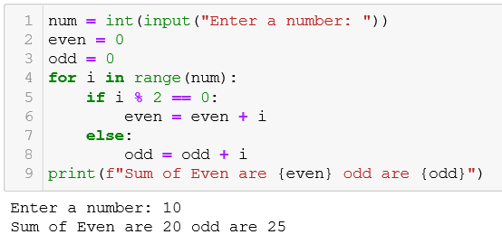
Example for loop
Program to Find the Sum of All Odd and Even Numbers
num = int(input("Enter a number: "))
even = 0
odd = 0
for i in range(num):
if i % 2 == 0:
even = even + i
else:
odd = odd + i
print(f"Sum of Even are {even} odd are {odd}")

Slide 17
while loop
The while loop in Python is used to iterate over a block of code as long as the test expression (condition) is true.
Condition: We generally use this loop when we don't know the number of times to iterate beforehand.
# Program to add natural # numbers up to
n = 10
sum = 0
i = 1
while i <= n:
sum = sum + i
i = i+1
print("The sum is", sum)
while test_expression:
Body of while

Slide 18
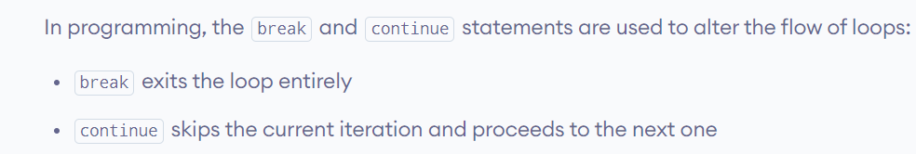
AI and Data Science
PYTHON PROGRAMMING
Conditions and Loops

Slide 19
break , continue statements
In Python, break and continue statements can alter the flow of a normal loop.
Loops iterate over a block of code until the test expression is false, but sometimes we wish to terminate the current iteration or even the whole loop without checking test expression.
The break statement terminates the loop containing it.
If the break statement is inside a nested loop (loop inside another loop), the break statement will terminate the innermost loop.
The continue statement is used to skip the rest of the code inside a loop for the current iteration only.
Loop does not terminate but continues with the next iteration.

Slide 20
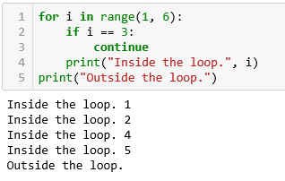
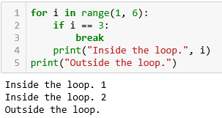
Example with break , continue statements
for i in range(1, 6):
if i == 3:
break
print("Inside the loop.", i)
print("Outside the loop.")
for i in range(1, 6):
if i == 3:
continue
print("Inside the loop.", i)
print("Outside the loop.")

Slide 21
else statement
With the else statement we can run a block of code once when the condition no longer is true:
i = 1
while i < 6:
print(i)
i += 1
else:
print("i is no longer less than 6")
for i in range(0, 10,2):
print(i, end=" ")
else:
print("\n No Break")

Slide 22
break continue pass
the break statement terminates the entire loop iteration, whereas the continue statement skips the current iteration.
continue forces the loop to start at the next iteration, whereas pass means, “there is no code to execute

Slide 23
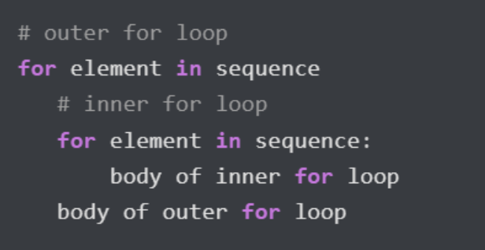
Nested Loops
A nested loop is a loop inside the body of the outer loop.
The inner or outer loop can be any type, such as a while loop or for loop.
    the outer for loop can contain a while loop and vice versa.
In each iteration of the outer loop, inner loop execute all its iteration.
For each iteration of an outer loop, the inner loop re-start and completes its execution before the outer loop can continue to its next iteration.

Slide 24
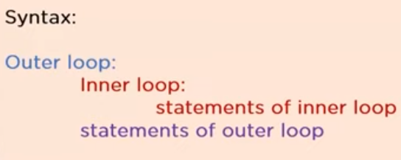
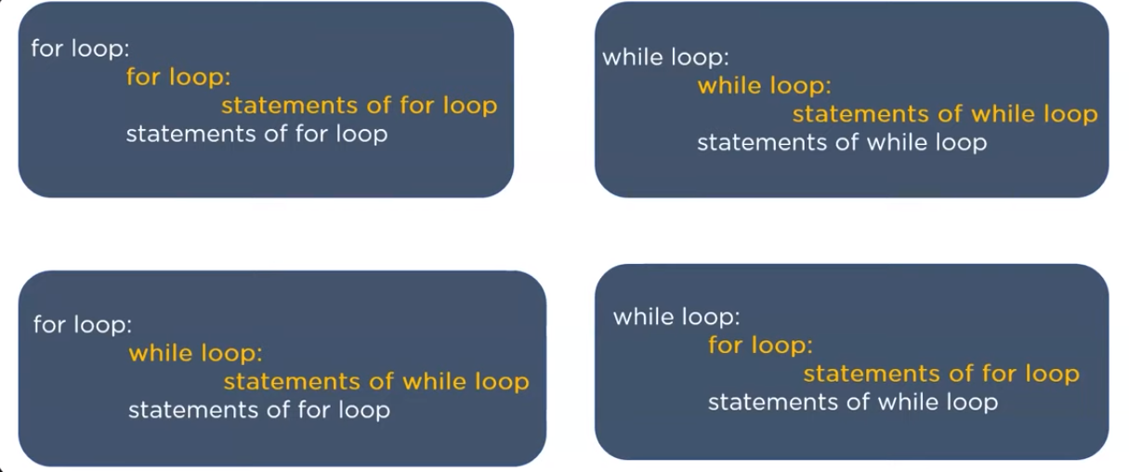

Slide 25
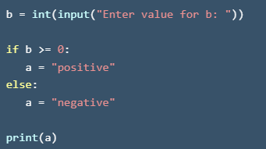
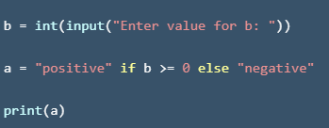

Single line if else statements/ ternary operator
The Python ternary operator (or conditional operator), tests if a condition is true or false and, depending on the outcome, returns the corresponding value — all in just one line of code.

Slide 26
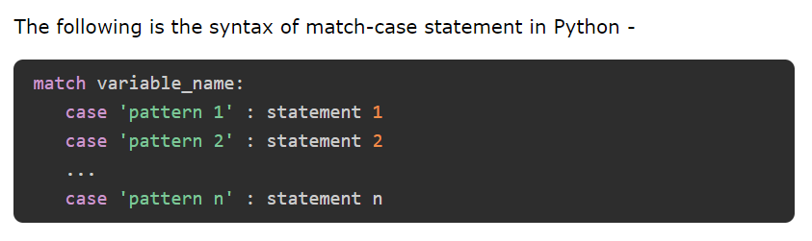
match-case
A Python match-case statement takes an expression and compares its value to successive patterns given as one or more case blocks.
The basic usage of match-case is to compare a variable against one or more values.
It is commonly encountered in languages like Rust, Scala, and Swift,
Wildcard _:
wildcard _ is a catch-all when none of the patterns match.
It ensures that no exceptions are raised in such cases.

